Slide 1

Medical - X-Ray -Bone
FRactuRe detection
(Binary Classification Problem)
TEAM ASSOCIATES :
K.PRASANTHI 20L61A0534
B. SHYAMALA 20L61A0511
G. PUJITHA 20L61A0525
A. HARSHA VARDHAN 20L61A0575
UNDER THE GUIDENCE OF
Mr. D. Promod Kumar
CSE DEPT

Slide 2
ABSTRACT
Requirement:
Classify between Fractured Bone and not Fractured Bone
Significance:
Accurate and timely detection of bone fractures is critical for effective medical treatment
and patient care.
Conventional methods of fracture detection often rely on manual interpretation of medical
images, which can be time-consuming and prone to human error.
Automating bone fracture detection using CNNs holds significant promise for improving
health care outcomes by facilitating early diagnosis and appropriate treatment interventions.
By expediting the diagnostic process and reducing reliance on human expertise, this approach
has the potential to enhance patient care, reduce health care costs, and alleviate the burden on
medical professionals, ultimately contributing to better over all patient outcomes and quality of
life.

Slide 3
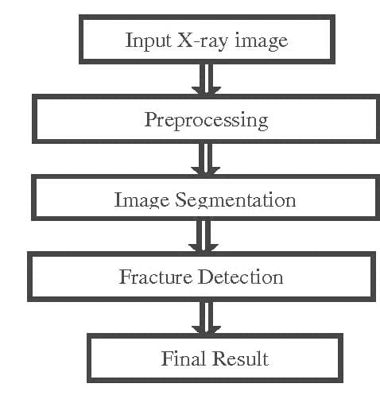
INTRODUCTION
Bones are the solid organs in the human body protecting many important organs such as brain , heart lungs and other internal organs .
The human body has 206 Bones with various shapes , size and structures .
There are different types of medical tools are available to detecting different types of abnormalities such as X – ray .
Computed Tomography (CT) , Magnetic Resonance Imaging (MRI) , ultrasound etc..
X – rays and CT are the most frequently used in fracture detection because it is the fastest and easiest way for the doctors to study the injuries of bones and joints .
Doctors usually uses X-ray images to determine whether a fracture exists , and the location of the fracture .

Slide 4
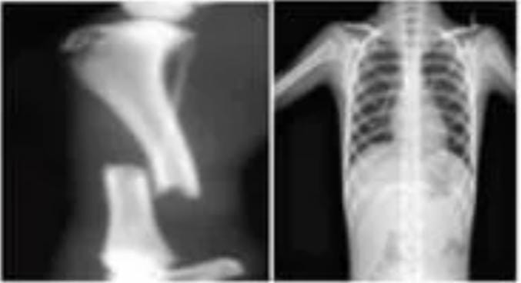
EXISTING SYSYTEM
This section includes data collection, augmentation of data transformations of the image
and finally classification of healthy cancerous bone using CNN.
The experiment has been performed on the bone X –ray image datasets, collected from different sources
publicly available for research such as Indian Institute of Engineering Science and Technology (IIEST)
The fractured and healthy bone shown in figure .
The most common sites for bone fractures are the wrist, ankle and hip.
Bone fractures are a very common injury and can effect anyone at
any age.
Fractured Bones can heal on their own but it take some time
like few months to a year .

Slide 5
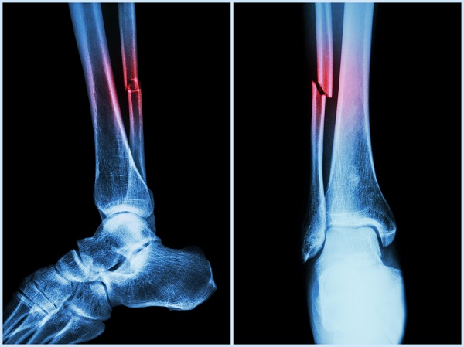
PROPOSED SYSTEM
The accuracy of such an ensemble model depends on several factors like :
Number and type of classifiers
Features used
Partitioning method ( Training and Testing sets )
The aggregation method and
Type of training .
A successful esembling depends on the design of the individual classifiers , selection of classifier and design of the fusion mechanism.
This section includes data collection, augmentation of data transformations of the image and finally classification of healthy cancerous bone using CNN.
The experiment has been performed on the bone X –ray image datasets, collected from different sources publicly available for research such as Indian Institute of Engineering Science and Technology (IIEST)
The fractured and healthy bone shown in figure .

Slide 6
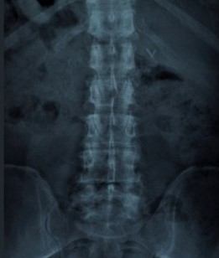
BONE FRACTURE : A COMMON INJURY
Bone fractures are a common injury, often requiring treatment accurate and timely diagnosis for effective.
Traditional methods of fracture detection have limitations.
Leveraging binary classifications can significantly improve accuracy and efficiency.
The most common sites for bone fractures are the wrist, ankle and hip.
Bone fractures are a very common injury and can effect anyone at any age.
Fractured Bones can heal on their own but it take some time like few months to a year .

Slide 7
REQUIREMENTS:
HARDWARE REQUIREMENTS :
System Processors : Core2Duo.
Hard Disk : 150GB.
Speed : 2.4 GHZ
SOFTWARE REQUIRMENTS :
Operating system : 32bitwindows 7 and on words.
Coding Language : Python
IDE : Spider
Database : MYSQL

Slide 8
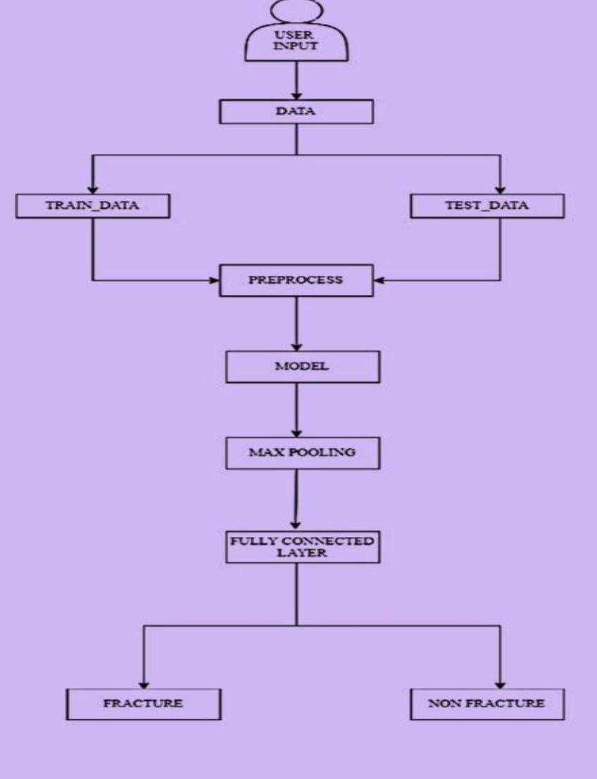
ARCHITECTURE

Slide 9
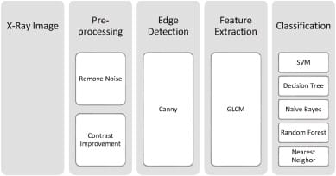
MODULES
MODULES OF BONE FRACTURE DETECTION :
The bone fracture detection system consists of four main modules , which are :
Preprocessing
Edge detection
Feature extraction
Classification

Slide 10
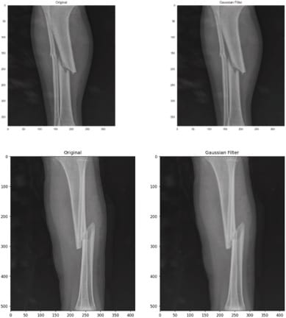
Pre-processing :
Since a majority of the real – life data acquired is noisy ,in-consistent, hence preprocessing of the acquired data plays a vital role.
Shows an example of applying noise removal and image smoothing on an x – ray image
CLASSIFICATION :
We randomly took 80% of dataset for the training session and 20% of the dataset for the testing .
Each category has its own properties, and the data that belong to that category also have those properties .
The accuracy of these classifiers can be evaluated using a variety of methods .
ALGORITHMS | PARAMETERS
Gaussian Naïve Bayes | Defaults
Decision Tree | Minimum sample Split = 40
Nearest Neighbors | No . of Neighbors = 30
SVM | Kernal = rbf, C = 10000
Random Forest | Defaults

Slide 11
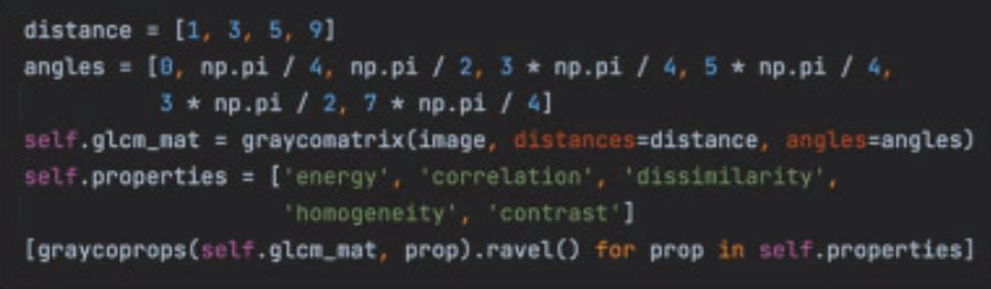
EDGE DETECTION :
Canny edge detection is a technique to extract useful structural information from different visions .
The quality of edge detection is heavily influenced by factors like as lighting , the presence of objects with similar intensities .
FEATURE EXTRACTION :
In many different applicants for image processing, the most important stage is feature extraction
Shows the extracted features for two images with distance =1 and angle =90 degrees .
IMAGE | ENERGY | CORRELATION | DISSIMILARITY | HOMOGENEITY | CONTRAST
1. | 0.2084321 | 0.99656732 | 2.91498663 | 0.4241376 | 21.55482951
2. | 0.0776263 | 0.99842039 | 1.53495146 | 0.56196655 | 7.74761016

Slide 12
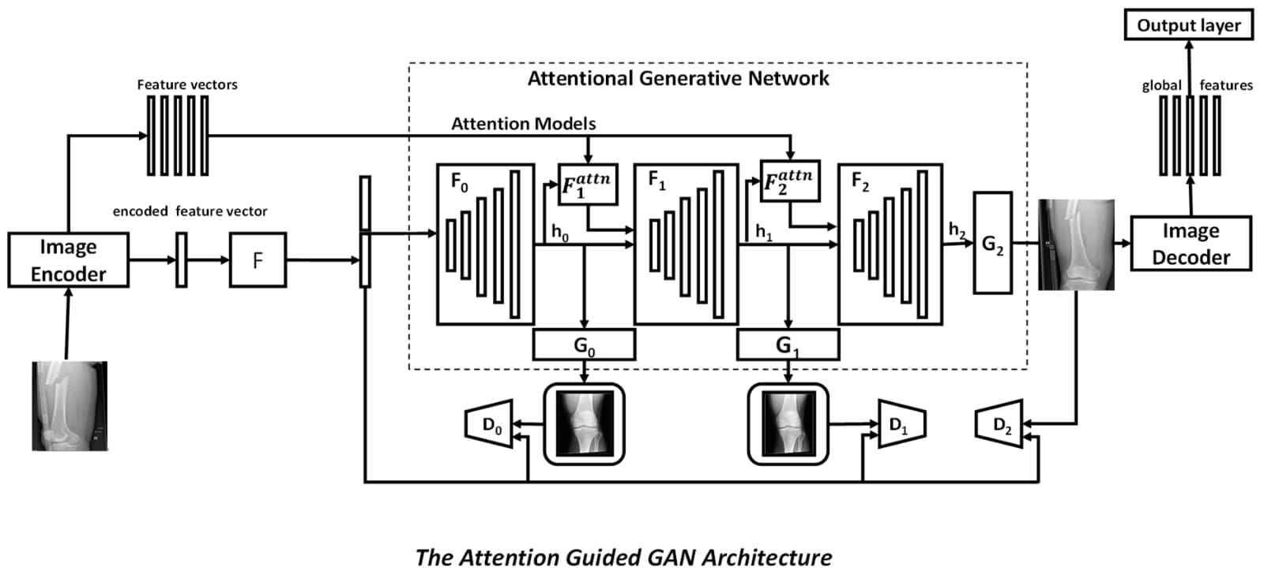
UML DIAGRAMS

Slide 13
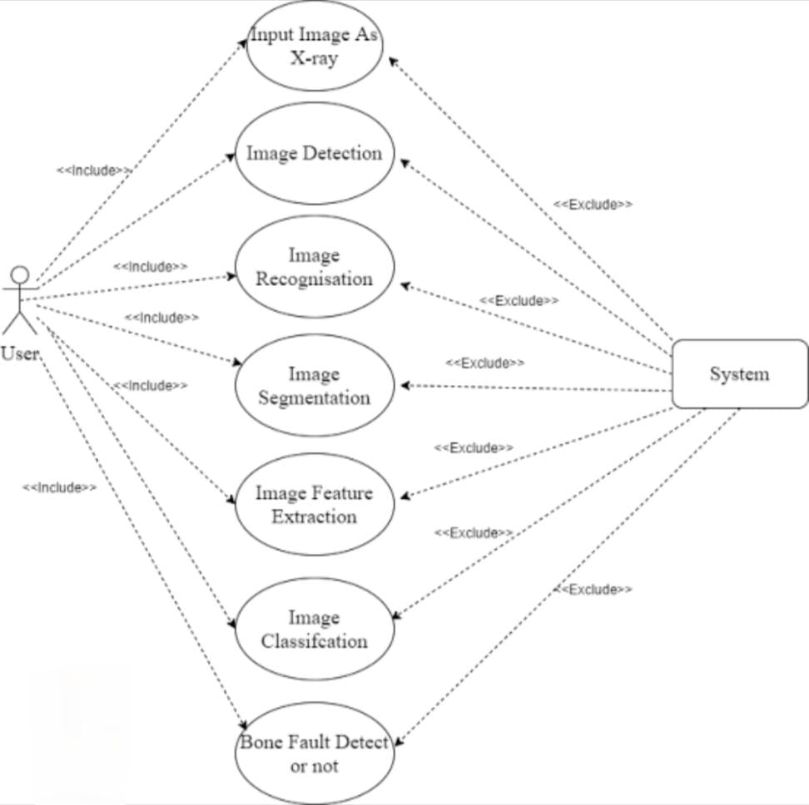
Use case diagram :

Slide 14
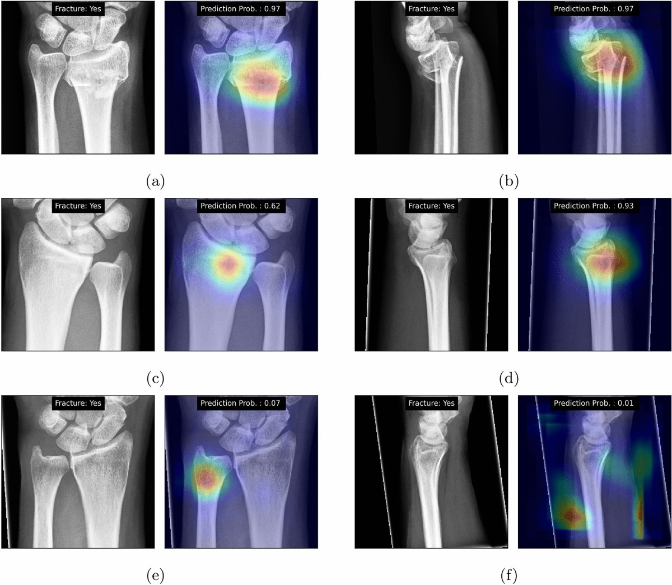
OUTPUT SCREENS

Slide 15
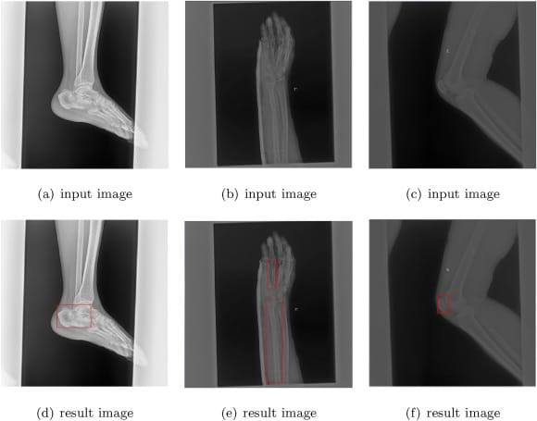
TESTING
X- rays usually confirm whether a person has a broken bone and where any loose bony pieces may be .
FRAX tool :
The FRAX tool has been developed to predict the risk of a fracture .
The tool combines your individual risk factors for fractures and your bone density scores .
If the x –ray does not show a fracture but your healthcare provider still thinks you might have one, other imaging tests may be necessary such as :
Magnetic resonance imaging (MRI)
Computed tomography (CT) scan

Slide 16
CONCLUSION
With the use of data that this project acquired, to investigated bone fractures using the Convolutional Neural Network technique in this research. Algorithm successfully determines which scans are fragmented and which are not.
Model is accurate to the tune of 70 to 87 per cent.
In this ppt bone fracture detection and classifications system using binary classification technique has been developed.
The X-ray image of the human fracture bone and the healthy bone were used to perform the experiment.
The images are been original which are collected from the different sources .
Finally they are 8873 images of bone data set and the are divided into 2 categories :
fractured and
Not fractured
The data set is divides into two
Training set and
Testing set
Training data images are 7099 and Testing data images are 1774.
The classification accuracy of the model is 92.44% for the healthy and fractured bone.

Slide 17
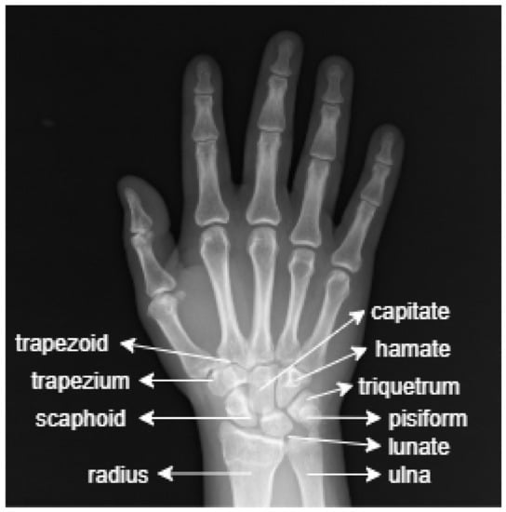
FUTURE ENHANCEMENT
The project aims to develop a robust and automated system for bone fracture detection using Convolutional Neural Network (CNNs).
Enhancing the efficiency and accuracy of fracture identification in medical imaging .
Facilitating early diagnosis and appropriate treatment interventions for better overall patient outcomes and quality of life.
Automating the process of bone fracture detection using CNNs has the potential to enhance patient care and reduce health care costs .
Reduce reliance on human expertise, leading to more consistent and accurate fracture identification in medical imaging .
Alleviates the burden on medical professionals, allowing them to focus on other critical aspects of patients care.

Slide 18
REFERENCES
Yangling Ma, Yixin Luo Bone Fracture Detection through the system of Convolutional Neural Network , Universities of science and technology of China, Hefei, 230026, PR China.
Anu T C, Mallikarujunaswamy M.S., Rajesh Ramana , Detection of Bone Fracture using Image Processing Methods, Department of Instrumentation , S.J . College of Engineering, Mysuru.
Wint Wah Myint, Khin Sandar Tun, Analysis on Leg Bone Fracture Detection and Classification Using X-ray Images Machine learning Research Vol 3, No 3,2018,pp 49-59.
Myint Wint Wah, Tun KS, Tun HM. Analysis on leg bone fracture detection and classification using x-ray images, 2018;3(3):49- 59
Dhiraj B, Prawaj A, Sumit D. A novel approach for bone fracture detection using image processing; 2018.

Slide 19


